Slide 1
CULTURAL CHANGES
GROUP MEMBERS: Bilal Shakeel Muhammad Tahir Muhammad Samamah Mujtaba

Slide 2
AGENDA
What is culture?
History of issues created by cultural changes
Statistics and researches
What causes cultural change?
Why cultural change is a problem
Figures trying to fend off cultural changes
How can cultural change issues be prevented?
Summary

Slide 3
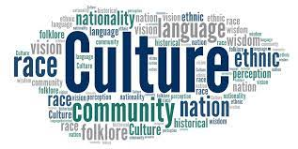
CULTURE
Culture is a collective programming of the mind that distinguishes the members of one group or category of people from another. This includes the religion of the group of specific people, the way they think, the beliefs and values they have and much more.

Slide 4
HISTORY OF CULTURAL CHANGE AS A SOCIAL ISSUE
The colonization of the Americas. European colonizers in the Americas caused a major cultural change for the native population, taking away their identity.
The French Revolution. The revolutionaries wanted to overthrow the traditions introduced by the Ancient Regime. However, it came at the cost of lives of thousands of people and a redefinition of the French national identity.
The Arab Spring. Series of uprisings in Arab led to changes in various Arab countries but it also led to civil war in countries like Syria and Yemen.

Slide 5
RESEARCHES AND STATISTICS
Research shows that:
Urbanization can lead increased stress, anxiety, and depression. Source: Berry, J. W. (2005). Acculturation: Living successfully in two cultures. International Journal of Intercultural Relations, 29(6), 697-712.
Cultural changes can cause struggles with identity formation, making people experience cultural dissociation. Source: Ward, C., Bochner, S., & Furnham, A. (2001). The psychology of culture shock. Routledge.
Economic turmoil. Cultural change can lead to traditional ways being implemented, mainly enforced by the authority in charge. Source: Inglehart, R., & Welzel, C. (2005). Modernization, cultural change, and democracy: The human development sequence. Cambridge University Press.
Struggles in Education. Cultural change can cause language barriers and differences in learning styles, hampering one's academics. Source: Ward, C., & Kennedy, A. (1994). Where's the "culture" in cross-cultural transition? Comparative studies of sojourner adjustment. Journal of Cross-Cultural Psychology, 25(4), 457-475.

Slide 6
MECHANISMS OF CULTURAL CHANGE
THERE ARE TWO MECHANISMS OF CULTURAL CHANGE:
INVENTION: A CULTURAL INVENTION IS ANY INNOVATION DEVELOPED BY PEOPLE. CULTURAL INVENTIONS INCLUDE SETS OF BEHAVIOR ADOPTED BY GROUPS OF PEOPLE.
DIFFUSION: CULTURAL DIFFUSION DESCRIBES THE SPREAD OF ONE CULTURE'S PRACTICES, BELIEFS, AND/OR ITEMS, LIKE FOOD, MUSIC, OR TOOLS. (DISCUSSED IN VIDEO)

Slide 7
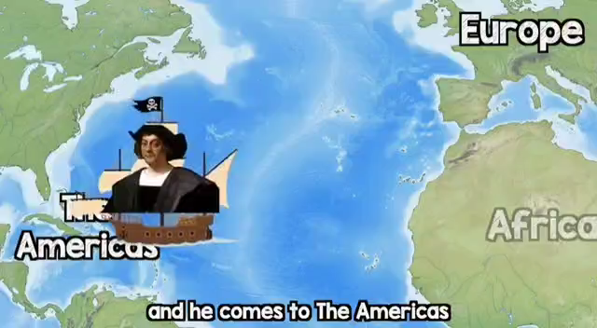

Slide 8
STATISTICS
According to a survey conducted by the American Psychological Association in 2017, people who live in urban areas are more likely to report feeling stressed than those who live in rural areas. In the survey, 47% of urban residents reported feeling stressed, compared to 37% of rural residents.
A survey conducted by the American Psychological Association in 2019 found that 54% of adults in the United States reported feeling unsure about their identity.

Slide 9
CAUSES
Technological advancements: New technologies often influence the way people live, work, and communicate, and can cause significant changes in cultural practices and values. Eg:increased use of phones and social media.
Globalization: The increasing interconnectedness of the world has led to the spread of ideas, values, and practices across cultures, which can lead to cultural blending and the emergence of new cultural practices.Eg:influence from hollywood/bollywood movies.
Environmental factors: Changes in the physical environment, such as natural disasters or climate change, can impact cultural practices and values as people adapt to new conditions.Eg: specialized designing of houses, food preparation.
Demographic shifts: Changes in population size, age structure, or migration patterns can also lead to cultural change, as different groups with diverse cultural backgrounds come into contact and interact with each other.Eg:large number of people migrating from rural to urban.
Political and economic factors: Changes in political systems or economic conditions can have significant impacts on cultural practices and values, as people adapt to new rules and systems.Eg;inflation lead to changes in lifestyle.

Slide 10
THEORIES THAT EXPLAIN CULTURAL CHANGE AS AN ISSUE
From a functionalist perspective, cultural practices and beliefs serve a function in maintaining social order and stability. When changes occur in the social structure, such as the development of new technologies or the emergence of new industries,
From a conflict perspective, cultural change is the result of social and political conflicts between different groups in society. As groups with different values and interests struggle for power and influence.Eg the civil rights movement of the 1950s and 1960s led to significant cultural change in the United States as African Americans challenged the dominant white power structure and fought for their rights. resulting in changes in laws,policies.
From a symbolic interactionist perspective, cultural change is seen as the result of changes in the meanings and symbols that people use to interpret their experiences and communicate with others and devise their own cultural practices.

Slide 11
MAIN FIGURES
Max Weber: He believed that cultural change could have profound effects on society, and argued that the rise of modern capitalism was a result of changes in cultural values and attitudes. Emile Durkheim: He argued that social change could lead to feelings of anomie, or a lack of social cohesion, which could have negative effects on individuals and society as a whole. Stuart Hall: He argued that cultural change can lead to new forms of identity formation, and that these identities can be shaped by cultural representations and discourses. Michel Foucault: He argued that cultural change can be a result of shifts in power relations, and that new forms of knowledge and discourse can shape the way people think about themselves and their social world. Edward Said: He argued that cultural change can lead to the domination of one culture over another, and that this can have negative effects on the dominated culture. Allama Iqbal: He was concerned about the impact of Western colonialism on Muslim culture and identity, and called for a revival of Islamic thought and culture as a way of resisting Western influence. Faiz Ahmed Faiz: He was concerned about the impact of capitalist and Western culture on Pakistani society, and called for a socialist revolution as a way of achieving social justice and equality.

Slide 12
HOW TO RESOLVE THESE ISSUES?
Education and awareness: Education and awareness-raising campaigns can be an effective way of promoting understanding and tolerance of different cultures. Pettigrew, T. F., & Tropp, L. R. (2006). A meta-analytic test of intergroup contact theory. Journal of Personality and Social Psychology, 90(5), 751–783.
Dialogue and communication: Dialogue and communication can be an effective way of building bridges between different cultural groups and promoting understanding and cooperation. Fiske, A. P. (2010). Envy up, scorn down: How status divides us. Russell Sage Foundation. This book examines how status divides people and the importance of empathy, understanding, and dialogue for bridging social and cultural differences.

Slide 13
Cultural Exchange: Cultural exchanges programs like YES Program, where students based on their merit are selected to go the US and promote their lifestyle and culture. This would help foreigners to better understand the culture of residents of countries they think lowly of. Policy and institutional change: Policy and institutional change can be an effective way of addressing cultural change as an issue. This can include efforts to promote diversity and inclusion in workplaces and public institutions. United Nations Educational, Scientific and Cultural Organization (UNESCO). (2015).
Community engagement and empowerment: This can include efforts to promote community-led initiatives that celebrate cultural diversity and promote cultural awareness. McMillan, D. W., & Chavis, D. M. (1986). Sense of community: A definition and theory. Journal of Community Psychology, 14(1), 6-23.
Respecting minorities: Although being in the minority side, rights of the minorities should be protected. They should be given freedom to do what they want.

Slide 14
SUMMARY
Cultural change will always remain an issue if there is no tolerance of other cultures and if the change is enforced on the natives. Cultural change will only be positive when it is accepted with mutual consent and as long as it does not change the identity of the group of people in question. Furthermore, it is of great benefit if one takes up the culture of a more advanced country for their own betterment and growth.

Slide 15

WE WOULD LOVE TO HEAR YOUR QUESTIONS!!

